Slide 1

CAR RENTAL MANAGEMENT SYSTEM
Concepts of Object Oriented Design – CSYE6200

Slide 2

TEAM MEMBERS
Niharika Santhoshini karri - 002727629
Sraddha peddagangireddy gari -002743943
Sahithi reddy Marapadaga - 002764442

Slide 3
PROJECT DESCRIPTION
Car rental management system is an advanced software solution meticulously designed to optimize the operations of a car rental agency. This sophisticated platform streamlines and automates the intricate processes of car availability, car search, car rental, and car return, while offering patrons an intuitive and user-friendly interface.
The car rental management system boasts dual authentication pathways: customer login and administrator login. The customer login grants clients the privilege to effortlessly search for available cars and proficiently manage their account particulars. Conversely, the administrator login empowers rental administrators and personnel to undertake administrative responsibilities, such as adding new cars, updating car records, and overseeing car circulation.

Slide 4
ANALYSIS
Streamlining and automation: The system's primary focus is on simplifying and automating various tasks, such as car availability, search, rental, and return. By automating these processes, the system can save time and effort for both customers and rental agency staff, leading to increased operational efficiency.
Intuitive and user-friendly interface: The system emphasizes providing an intuitive and user-friendly interface, which is essential for enhancing user experience and ensuring that customers can easily navigate through the system to find and rent cars. A user-friendly interface can reduce the learning curve for new users and encourage repeat usage.
Efficiency and customer satisfaction: The primary objective of the car rental management system is to improve operational efficiency, thereby leading to enhanced customer satisfaction. By automating tasks and providing an intuitive interface, the system can expedite the rental process, reduce waiting times, and minimize potential errors or discrepancies.
Integration of cutting-edge technology: The description mentions the seamless integration of cutting-edge technology, indicating that the system likely leverages modern software development practices and tools to deliver efficient and effective solutions. This suggests that the system may be able to handle a significant volume of data and transactions, as well as provide real-time updates.
The designed system is a sophisticated and well-designed software solution aimed at enhancing the operations of a car rental agency.

Slide 5

OVERVIEW
SYSTEM ADMIN – Manages cars , clients and the whole system
CUSTOMER – Searching , booking and returning cars
CAR MANAGEMENT – Add, Update and delete Cars, Customers and tracking the availability of cars
SYSTEM ADMIN
CUSTOMER
CAR MANAGEMENT

Slide 6
TECH STACK
Java
Java FX
Scene Builder
MySQL
Eclipse
JDBC
Java Collections

Slide 7
CONTRIBUTIONS
Niharika Santhoshini Karri - Customer Sign-in & Sign-Up, Customers Management, Customer Operations Screen
Sahithi Reddy Marapadaga – Car Search, Cars Return, Car Issue Page, Car Management
Sraddha Peddagangireddy gari - Home Screen, Admin Operation Screen, Admin Sign-in, Customer Profile

Slide 8
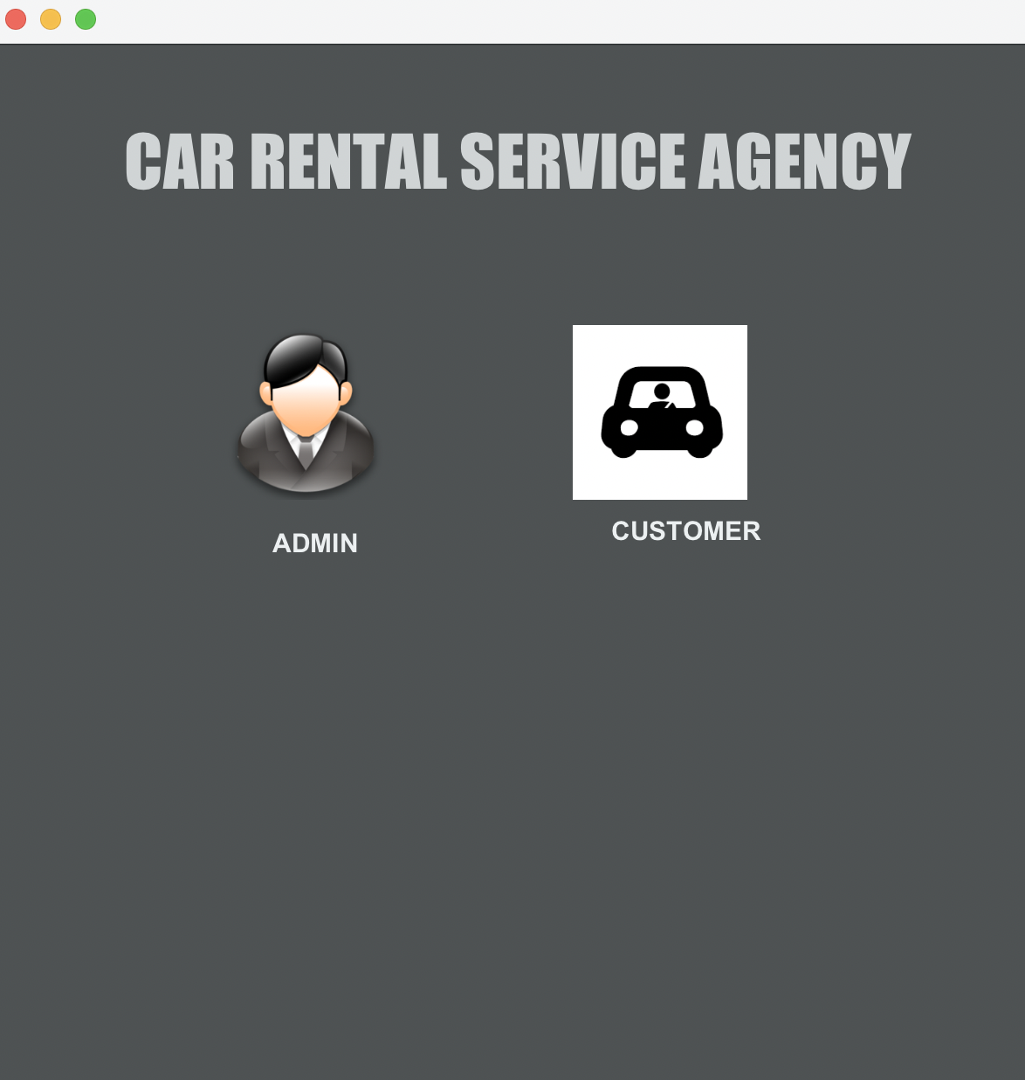
HOME SCREEN

Slide 9
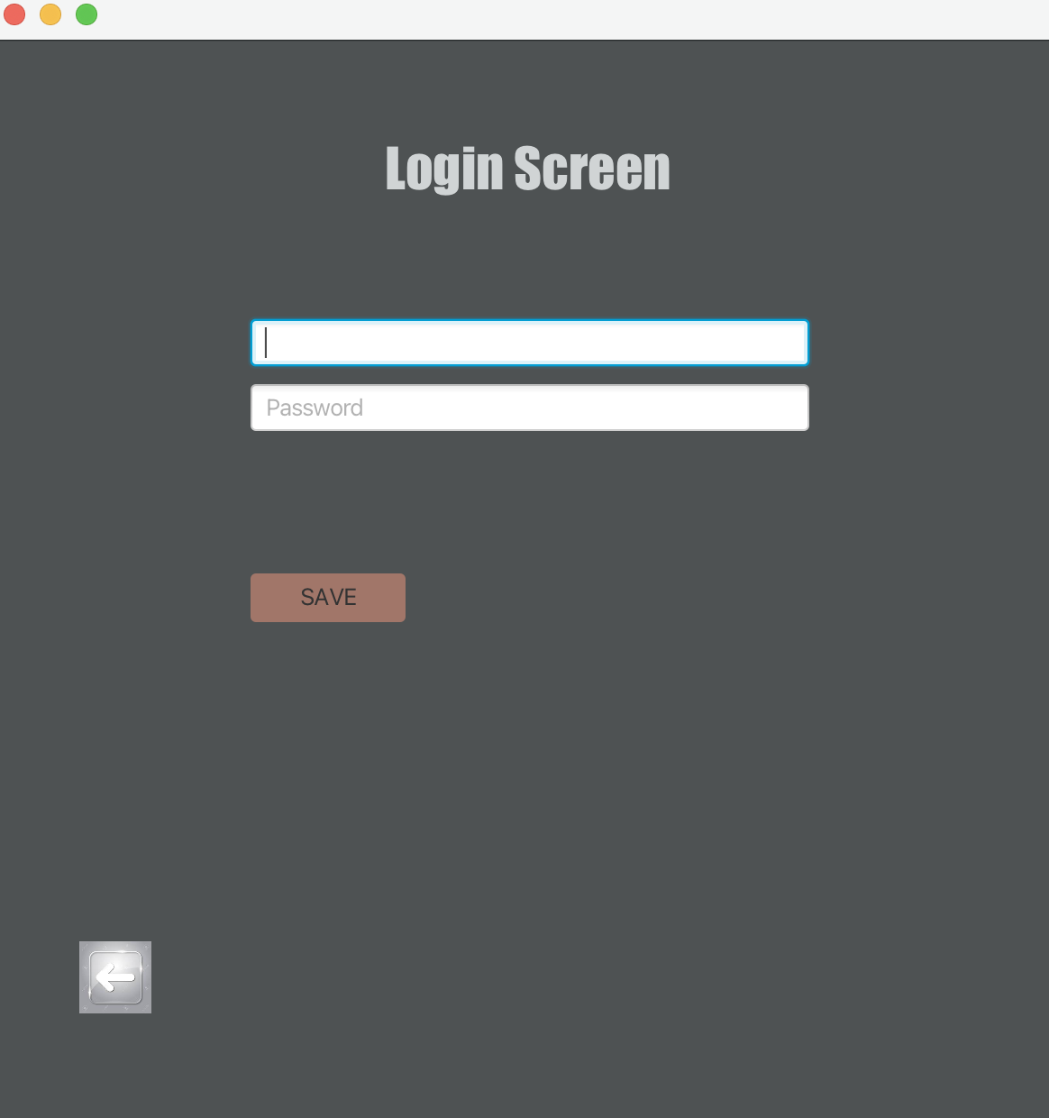
LOGIN SCREEN

Slide 10
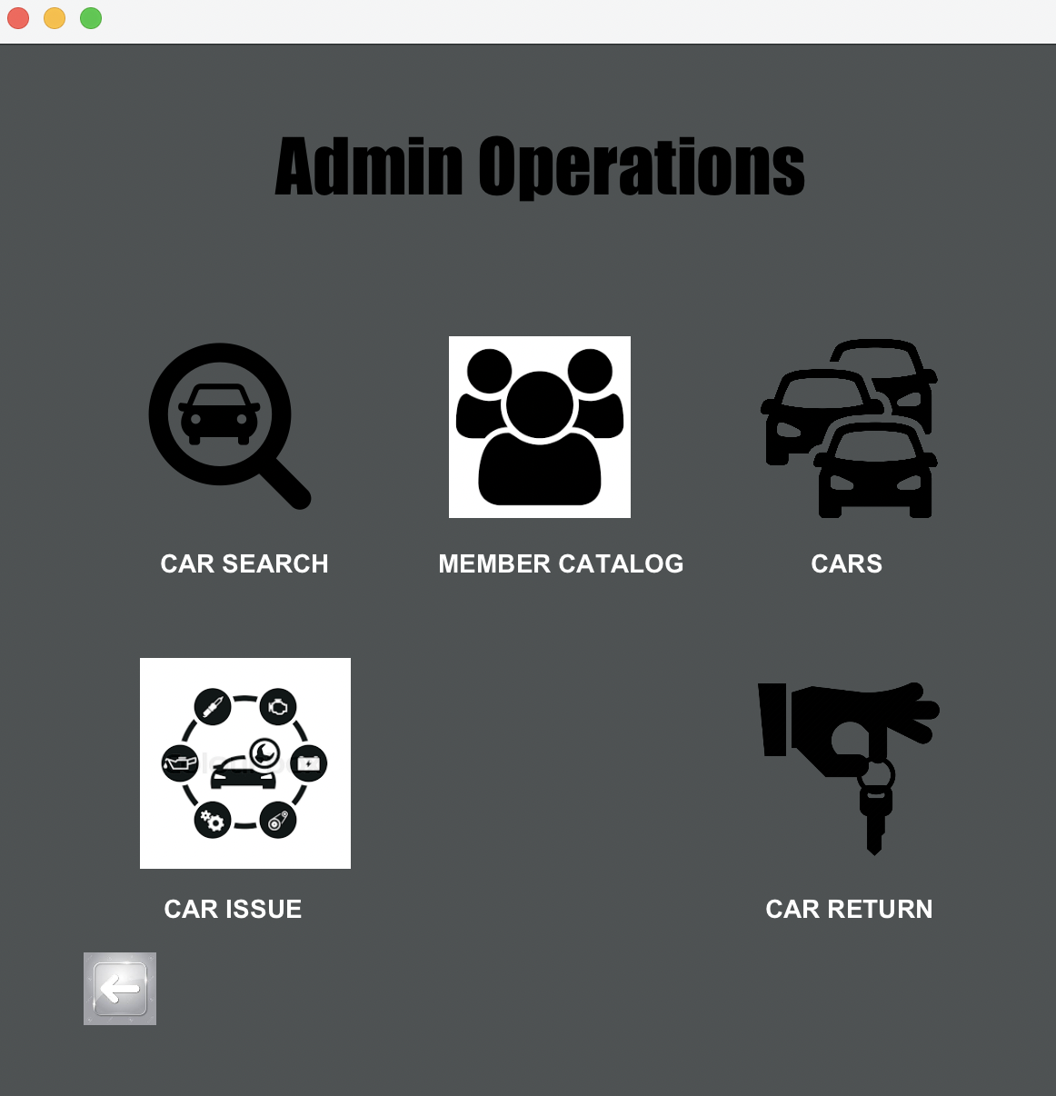
ADMIN OPERATIONS PAGE

Slide 11
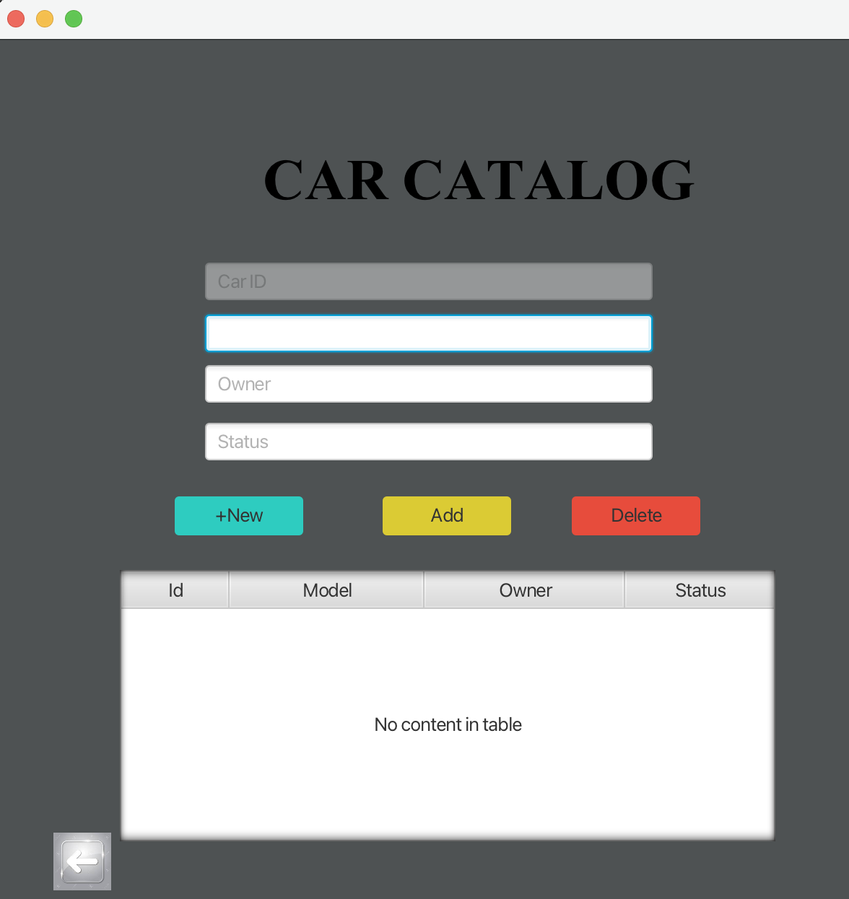
CAR CATALOG

Slide 12
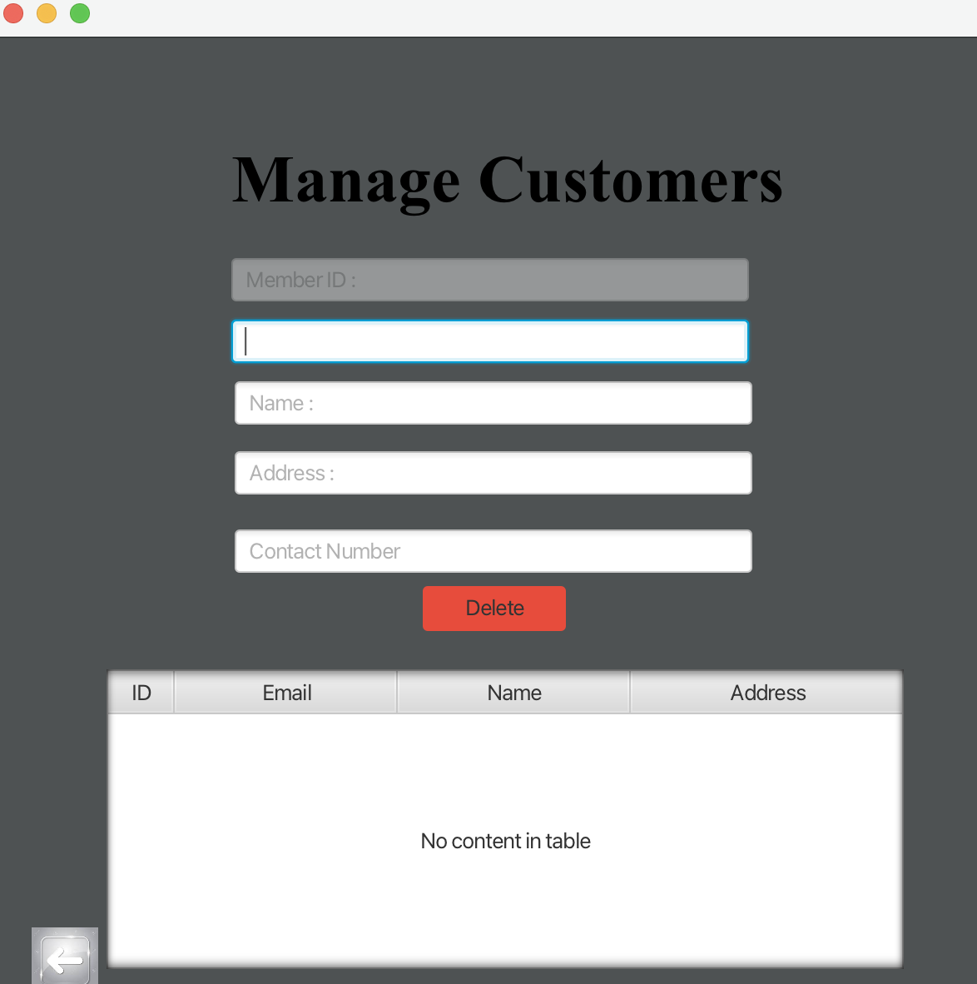
MANAGE CUSTOMERS PAGE

Slide 13
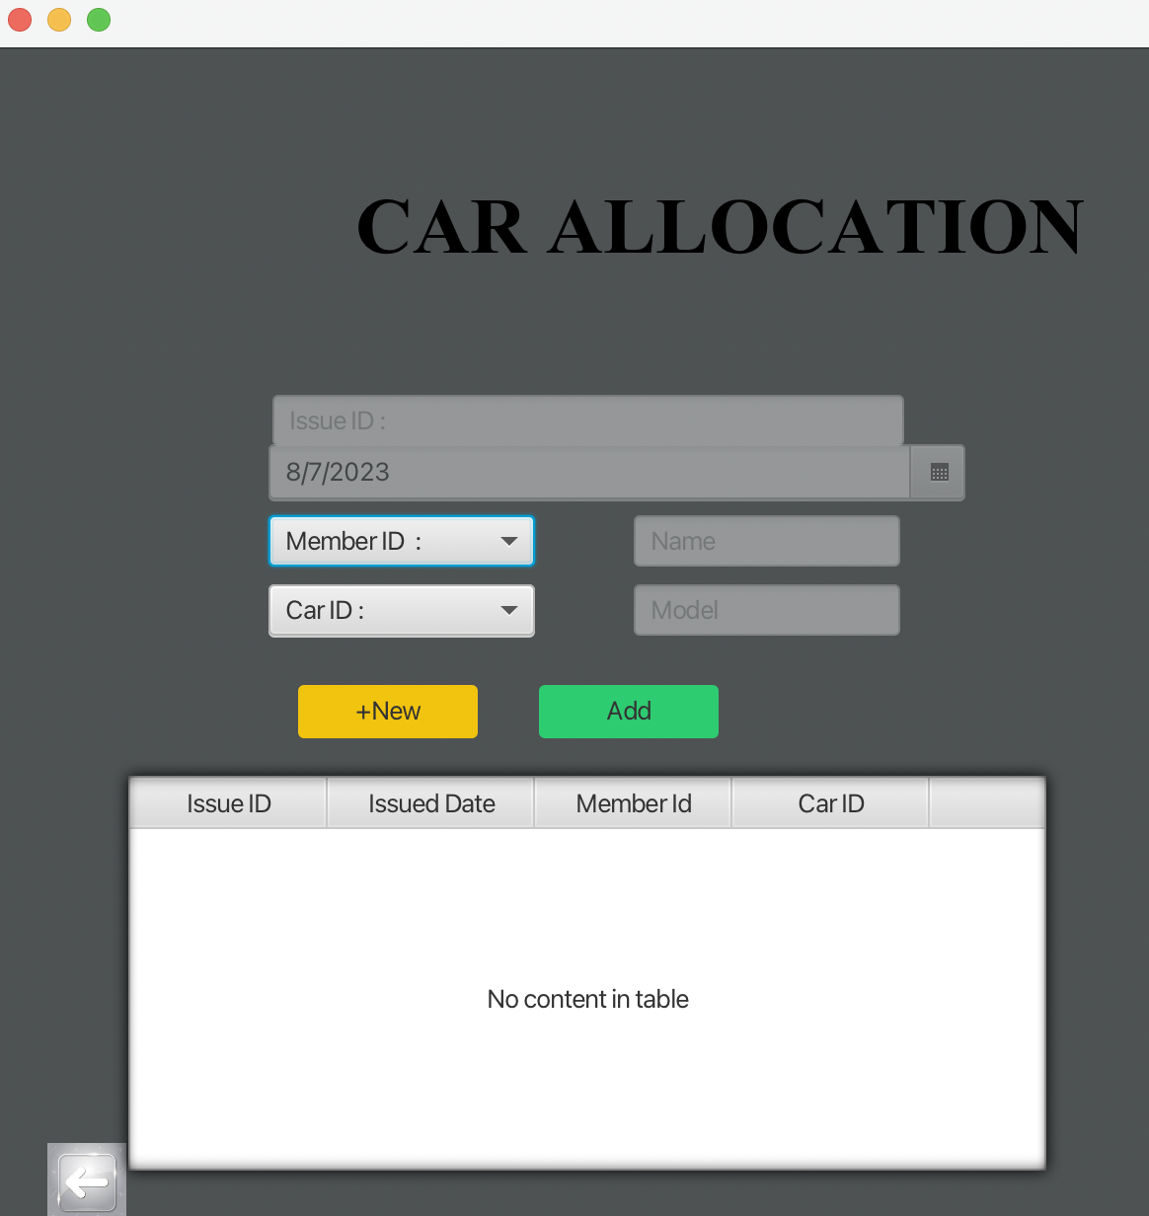
CAR ISSUE PAGE

Slide 14
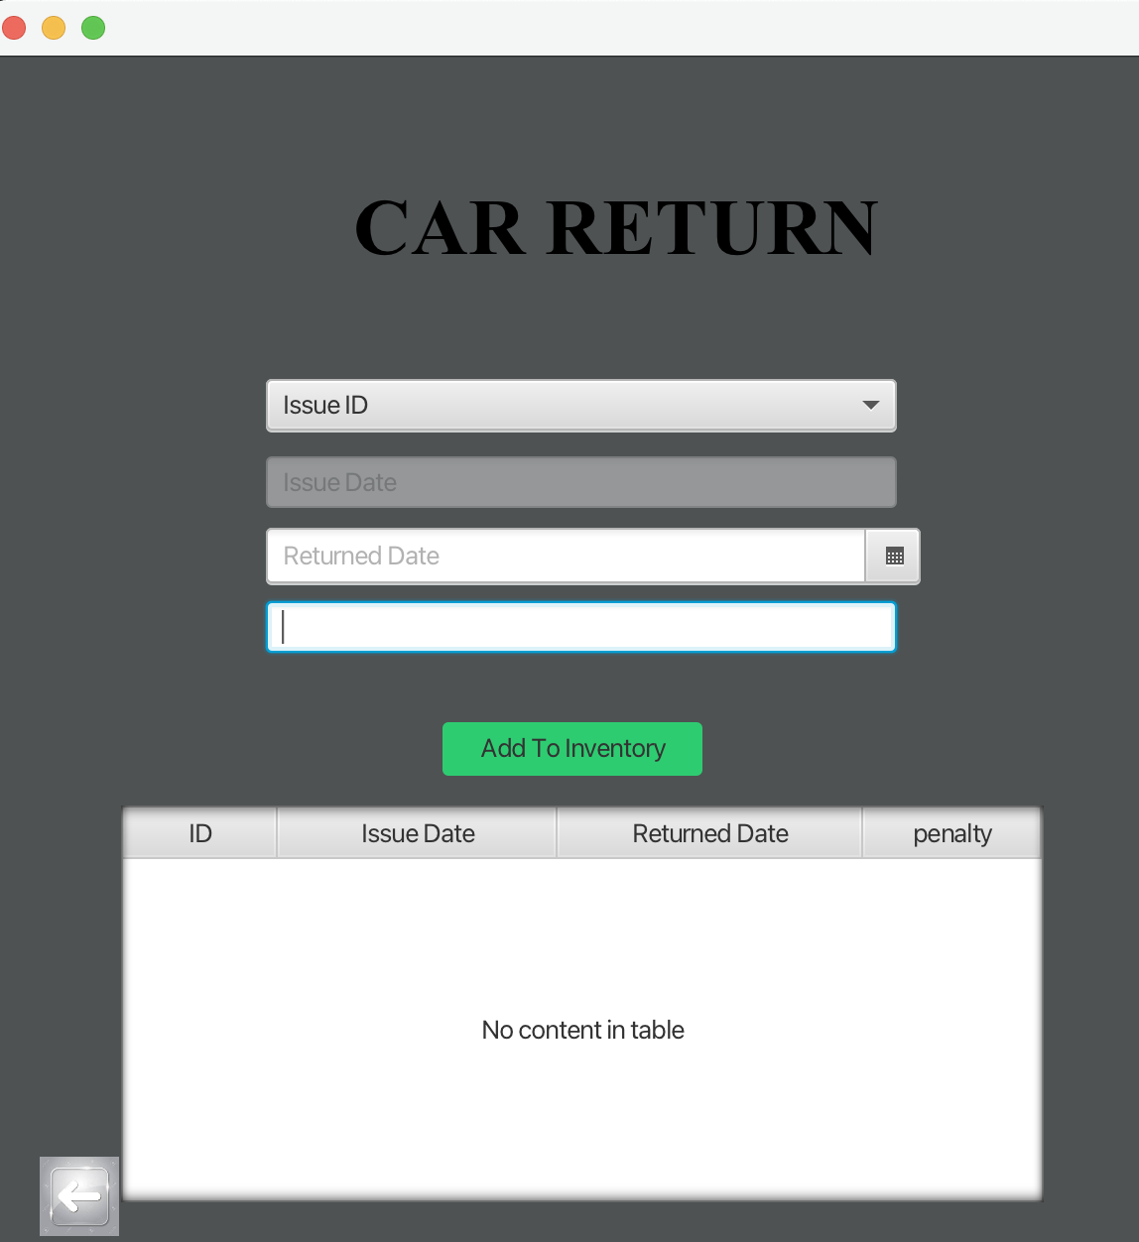
CAR RETURN PAGE

Slide 15
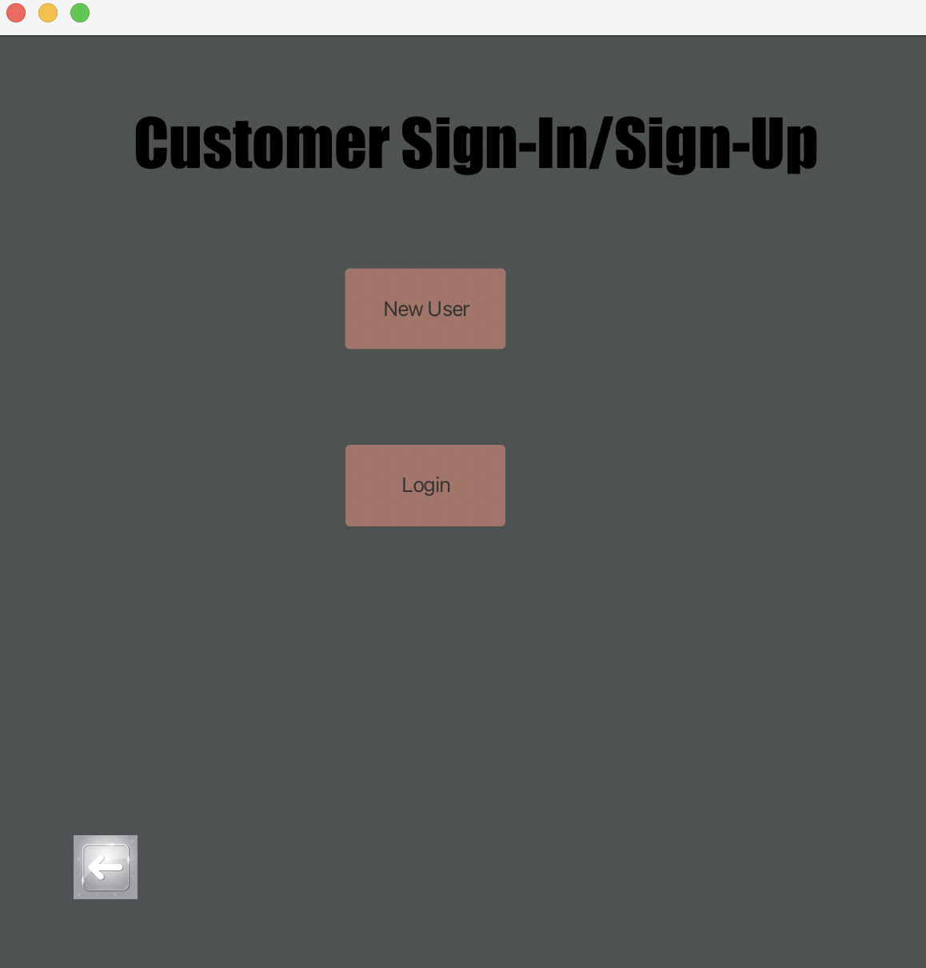
CUSTOMER SIGN IN PAGE

Slide 16
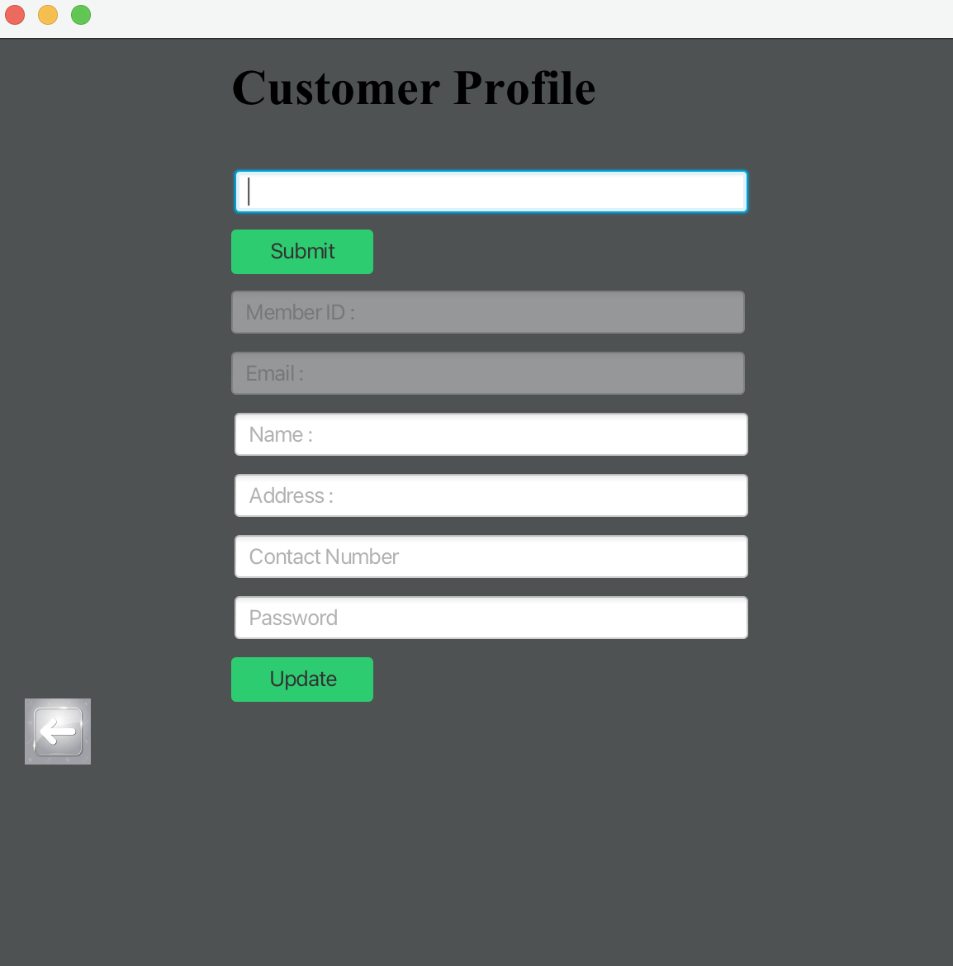
CUSTOMER SIGN UP PAGE

Slide 17
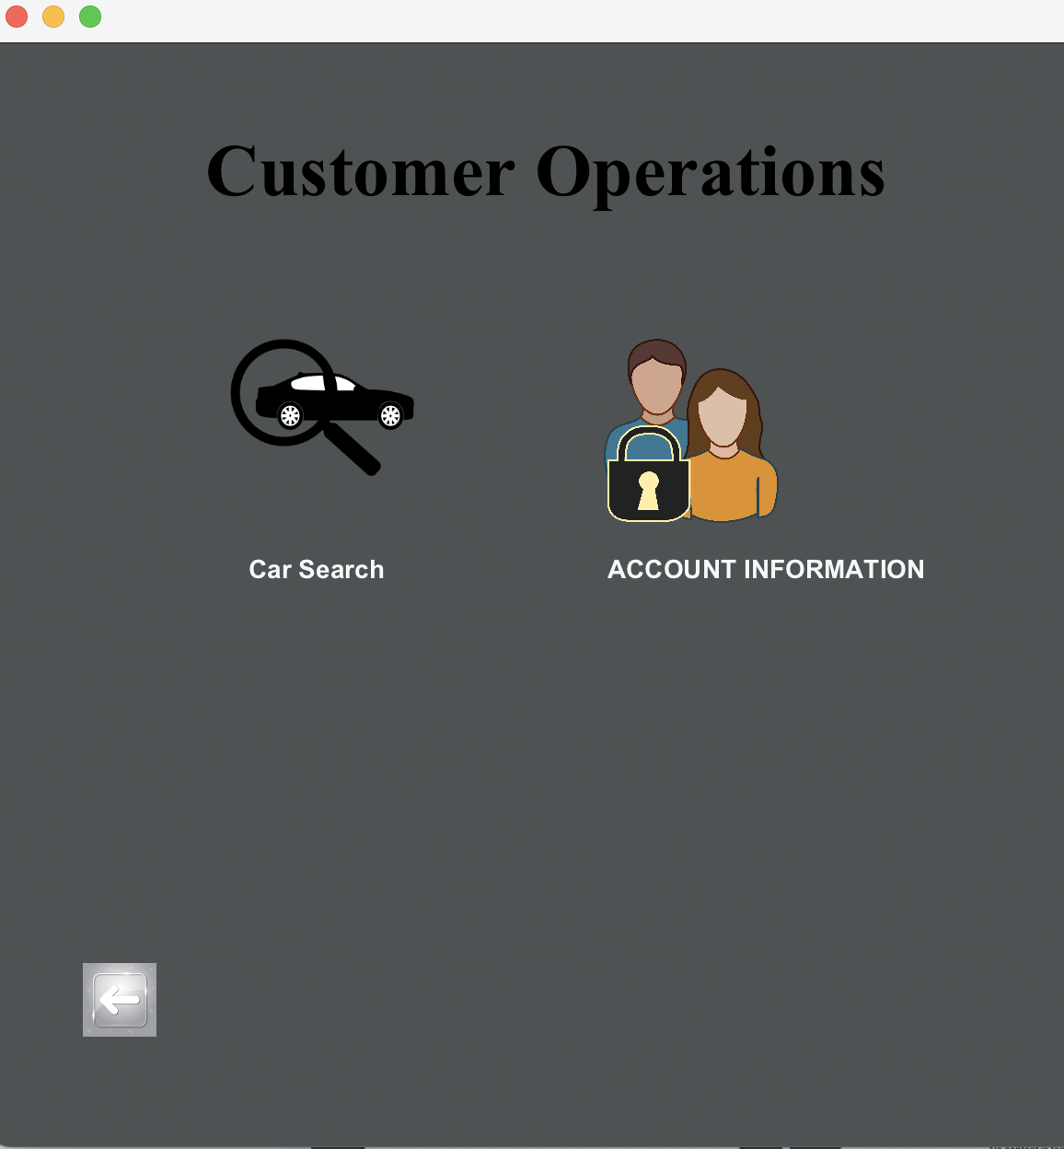
CUSTOMER OPERATIONS SCREEN

Slide 18
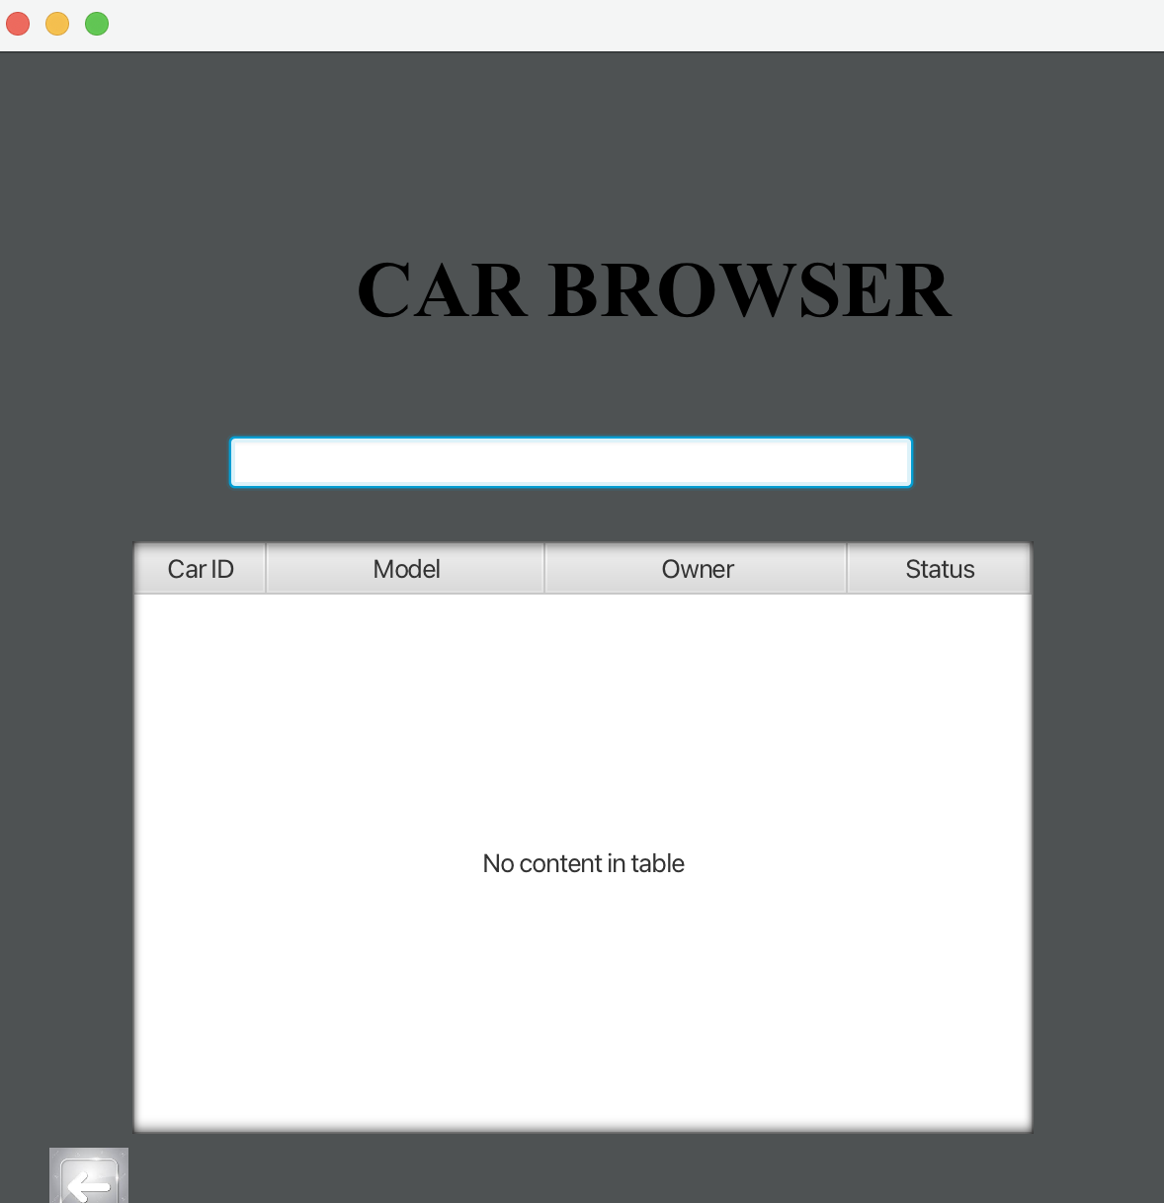
CARS SEARCH SCREEN

Slide 19

REFERENCES
Car Rental From Wikipedia : https://en.wikipedia.org/wiki/Car_rental
Car Rental System from Research gate : https://www.researchgate.net/publication/353174644_Car_Rental_System
What are the benefits of online car rental software?
https://rentrax.com/what-are-the-benefits-of-online-car-rental-software/

Slide 20


